Slide 1
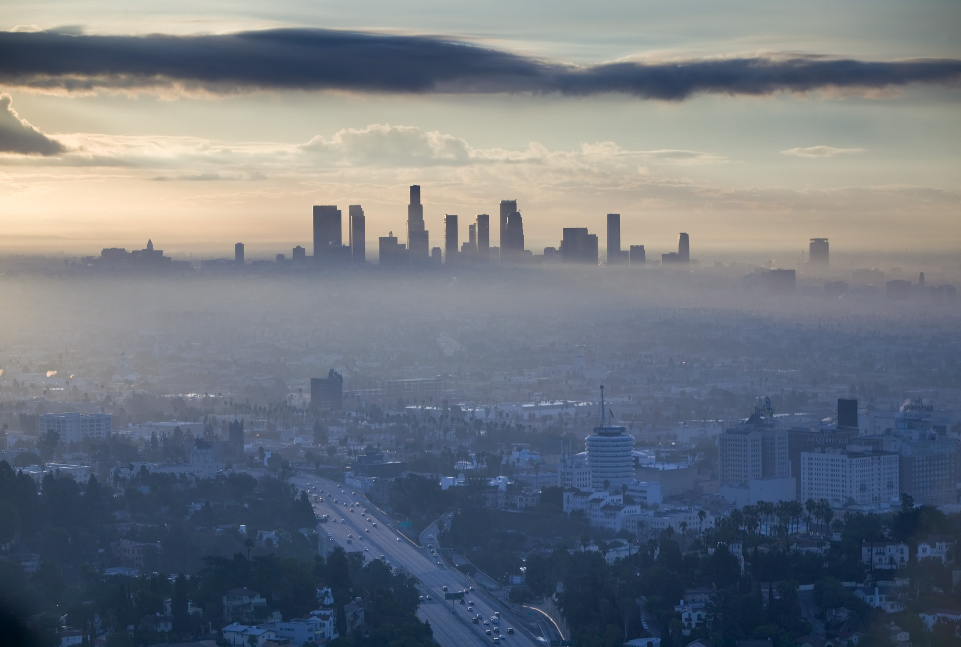
Decreasing Ozone in Los Angeles
By Deven Morris

Slide 2
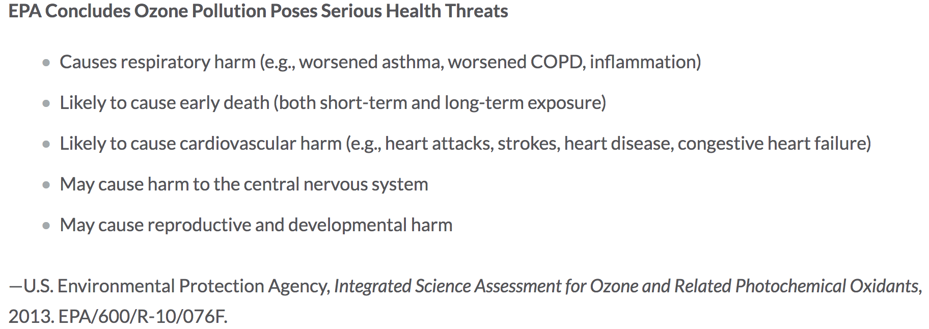
Hazards of Ozone

Slide 3
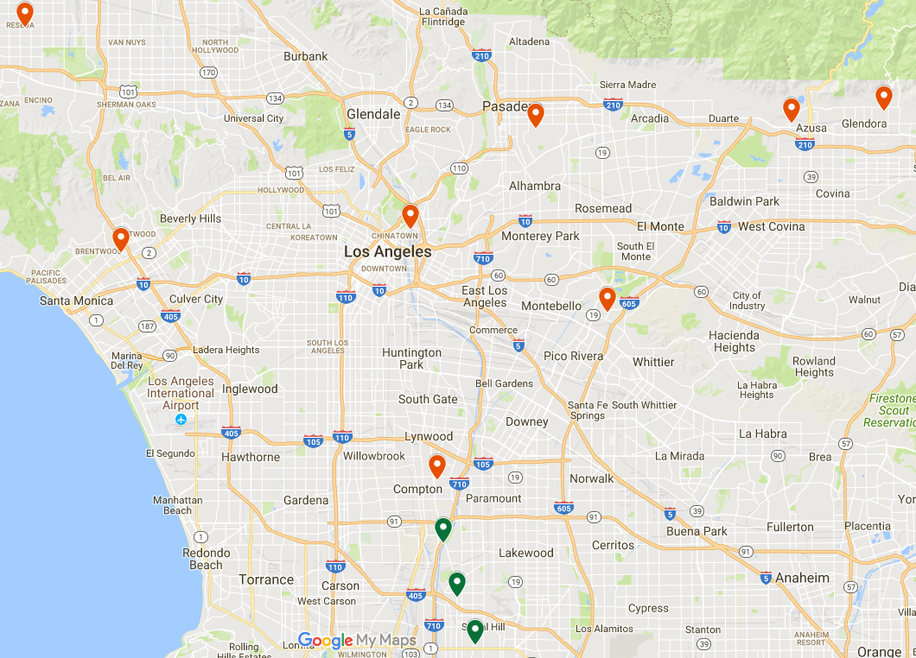


Area Concerned
Problematic
Okay

Slide 4
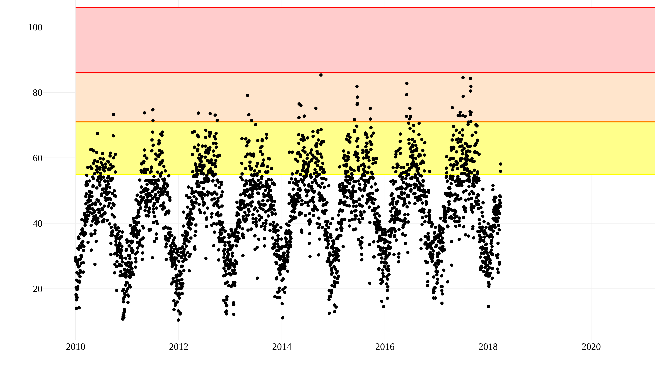
Data
Unhealthy
Sensitive Pop.
Moderate
Ozone ppb
Year

Slide 5
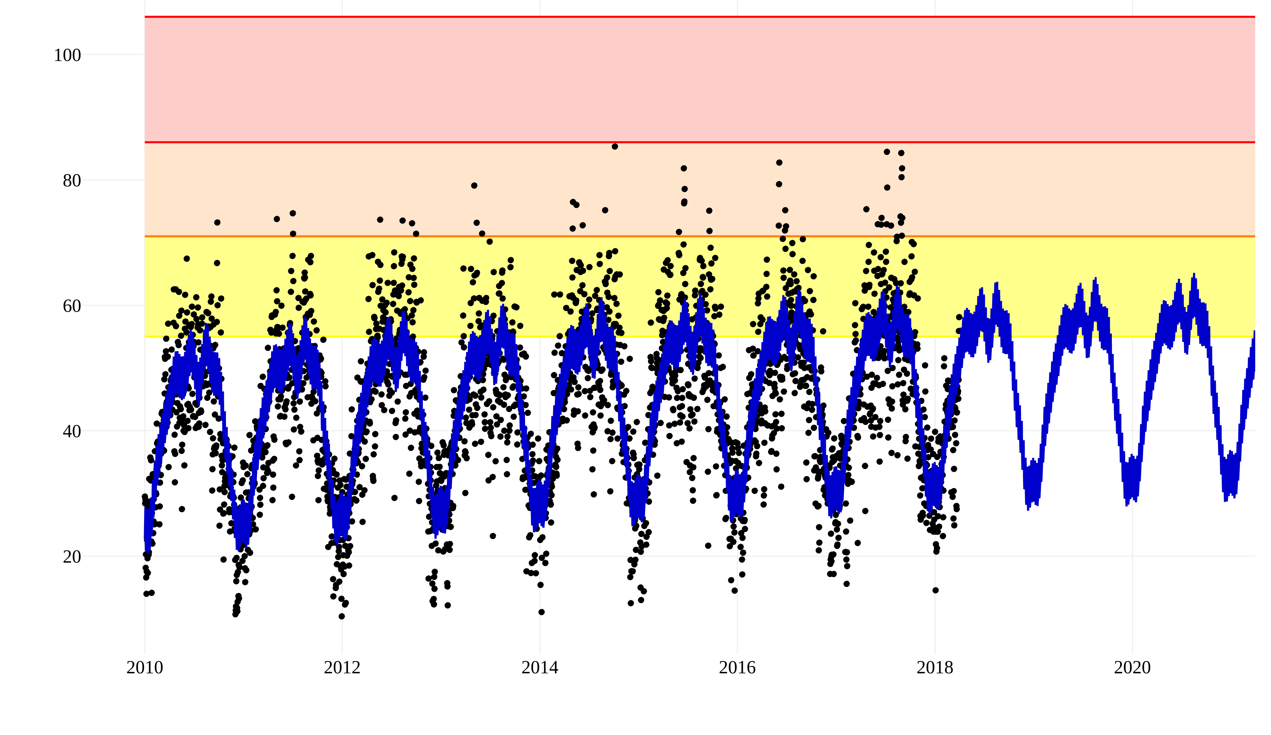
Model Fit
Unhealthy
Sensitive Pop.
Moderate
Ozone ppb
Year

Slide 6
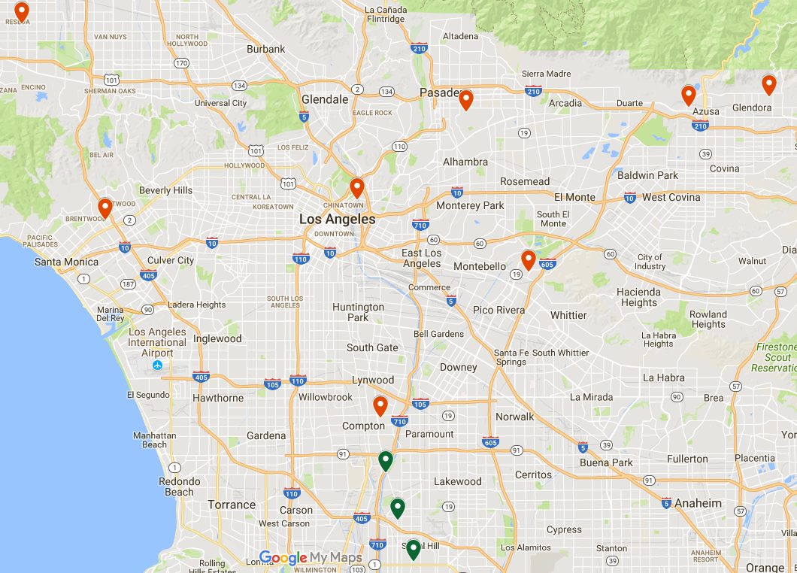
Sites of Interest
60370002
Problematic
Okay
High Levels
Large Rate

Slide 7
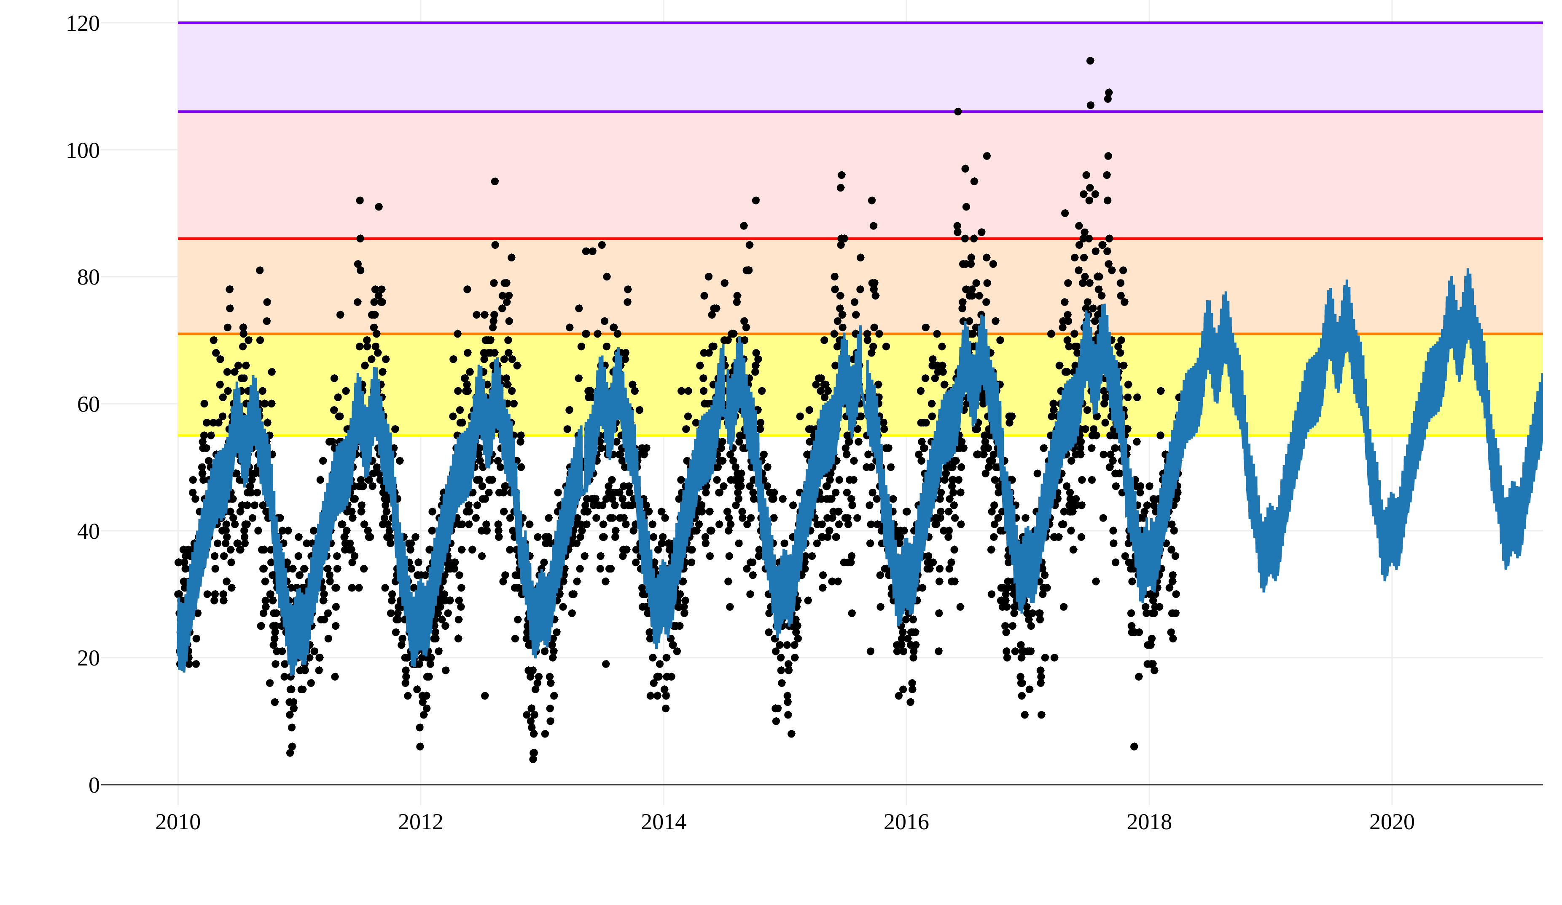
Site 60370002
Very
Unhealthy
Unhealthy
Sensitive Pop.
Ozone ppb
Moderate
Year

Slide 8

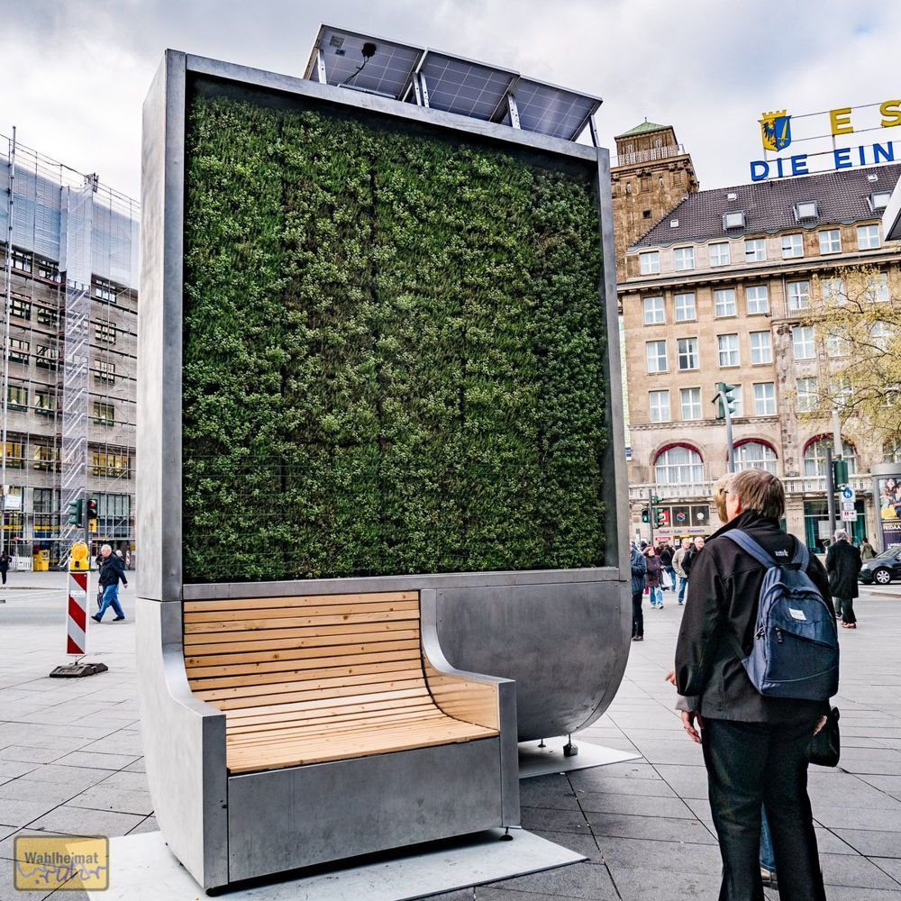
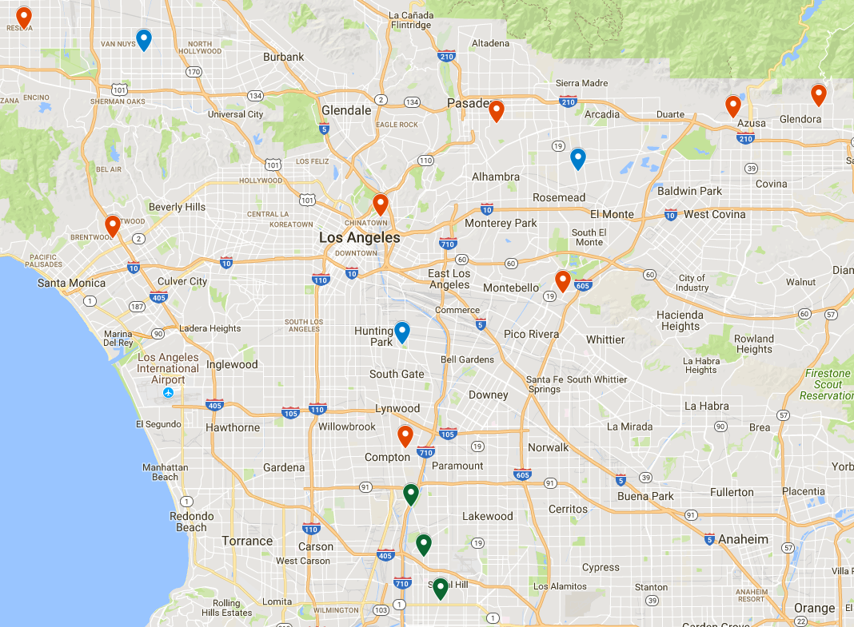
Recommendations
CityTree
CityTree Locations

Slide 9
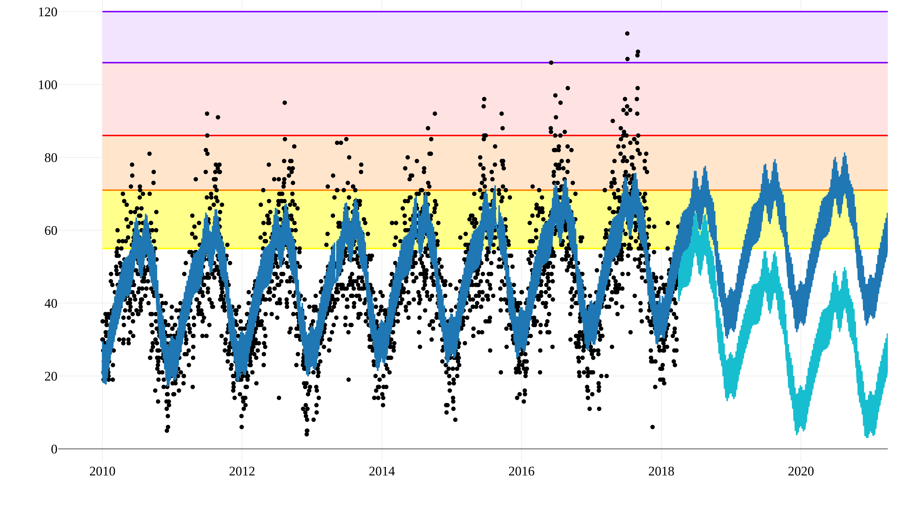
Projected Site Trend
Very
Unhealthy
Unhealthy
Sensitive Pop.
Ozone ppb
Moderate
Year

Slide 10


Next Steps
Investigate Causes
Apply to other cities

Slide 11


Thank You!
Deven Morris
djmorcode@gmail.com
913-710-7753
djmor12/
djmor/
Data: Ozone, Ozone2, News, Hazards Research: Abs. Rates, Generators, AQI
Green Tech: CityTree, Vertical Forest, General

Slide 12
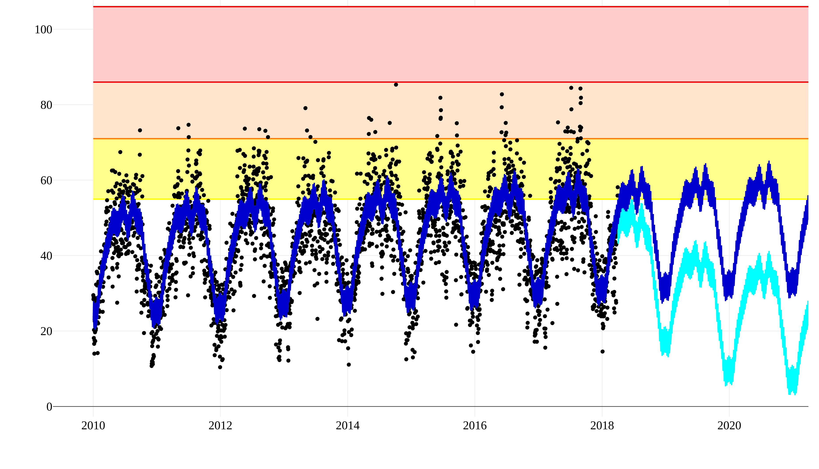
Projected L.A. Trend
Very
Unhealthy
Sensitive Pop.
Moderate
Ozone ppb
Year

Slide 13
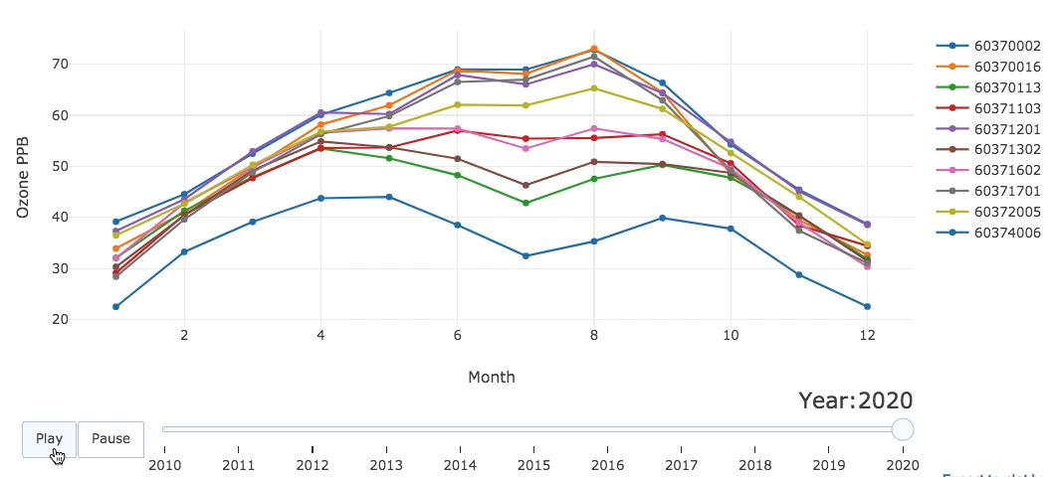
Ozone Change over Time

Slide 14
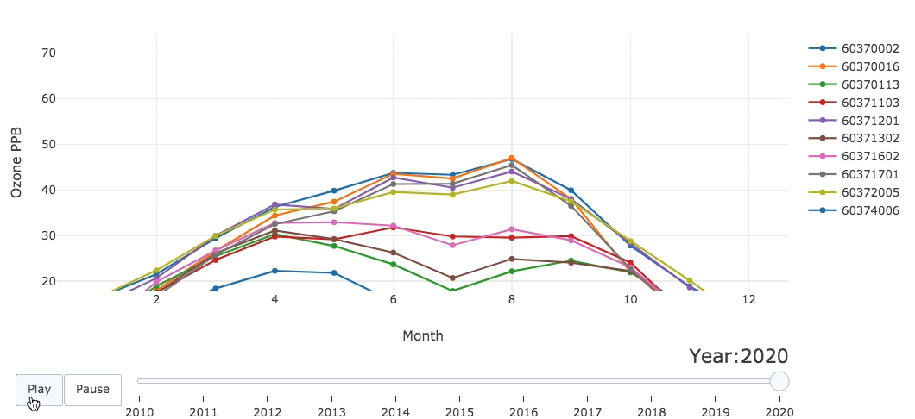
Ozone Change over Time

Slide 15
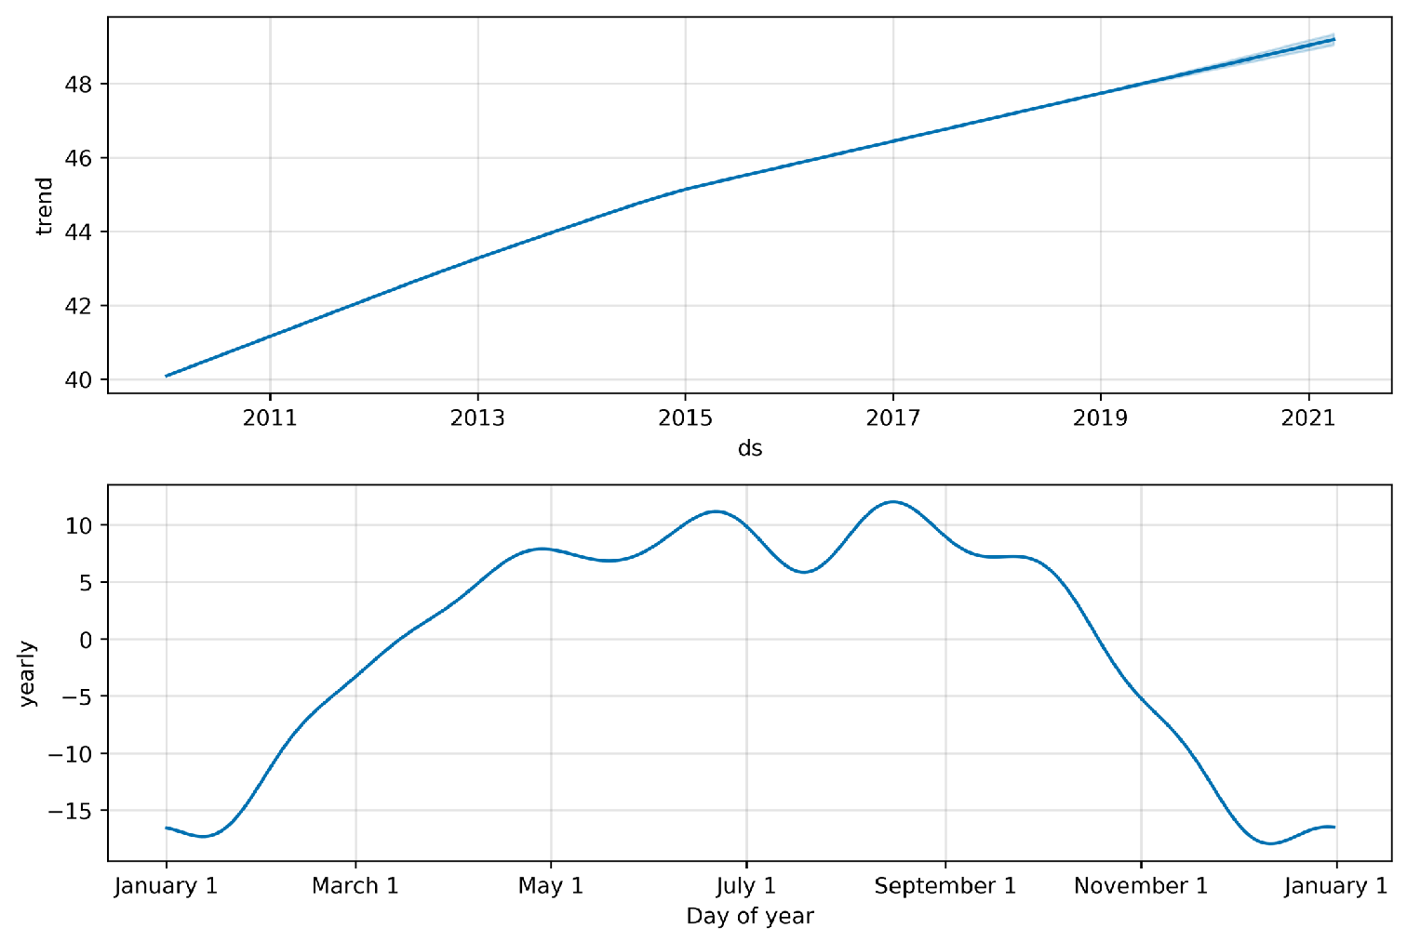
Model Fit Components

Slide 16
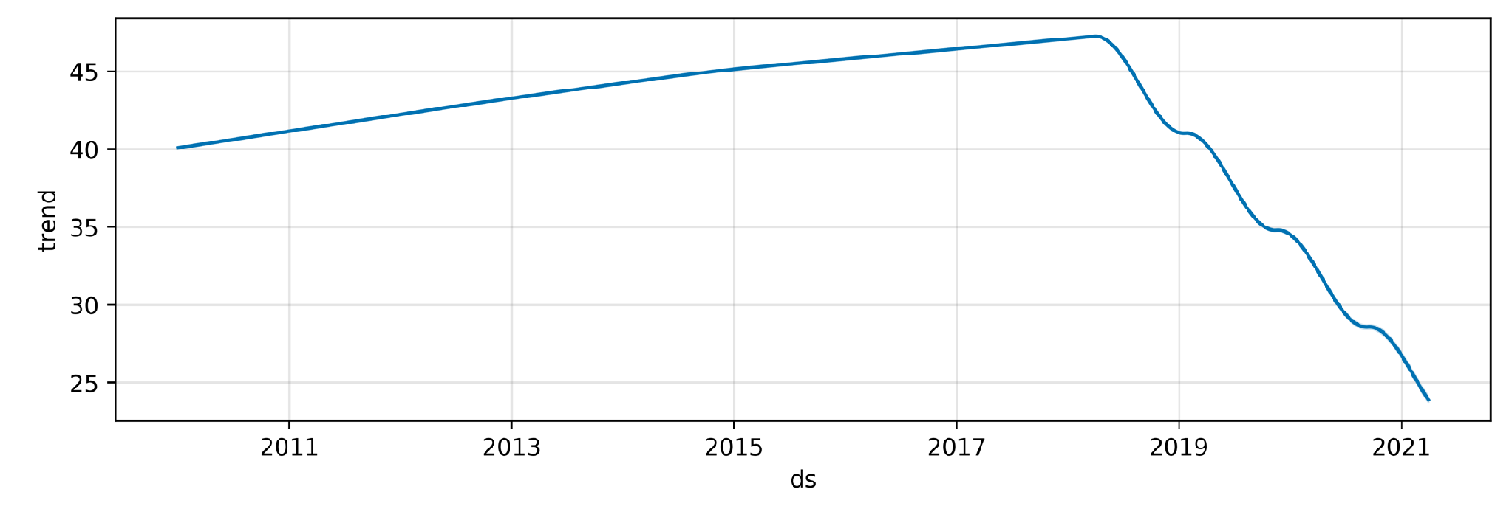
Project Trend: 3 CityTrees

Slide 17
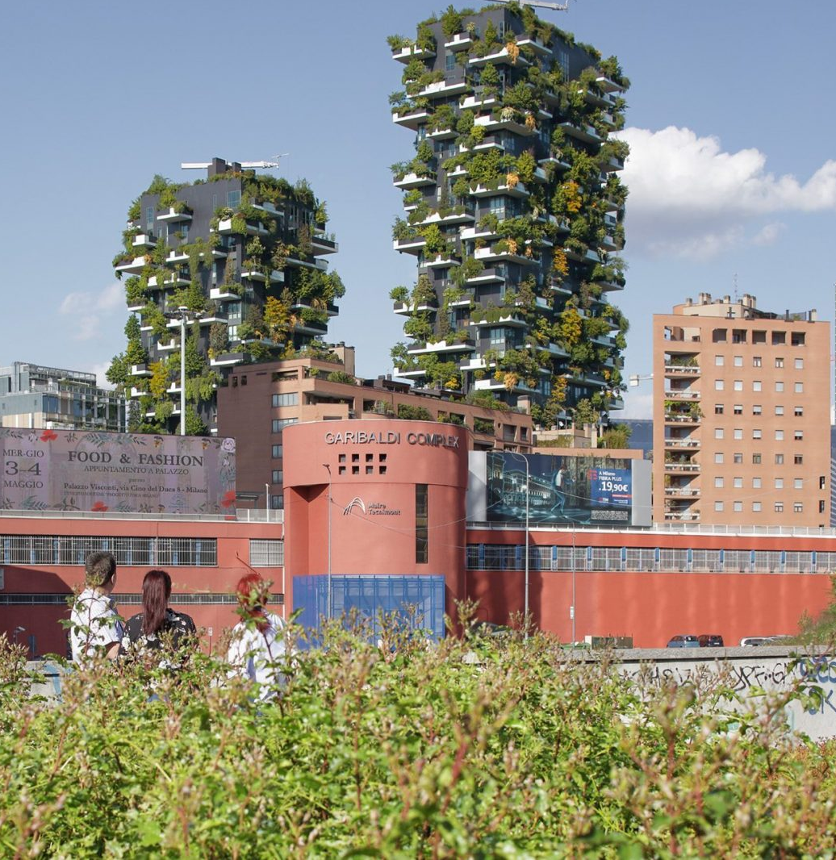
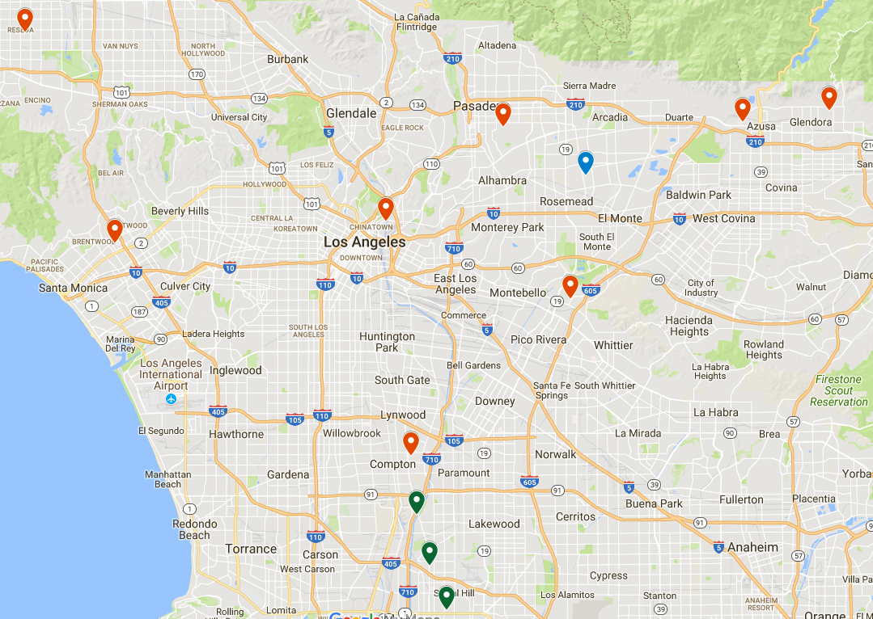
Recommendations
Vertical Forest

Slide 18
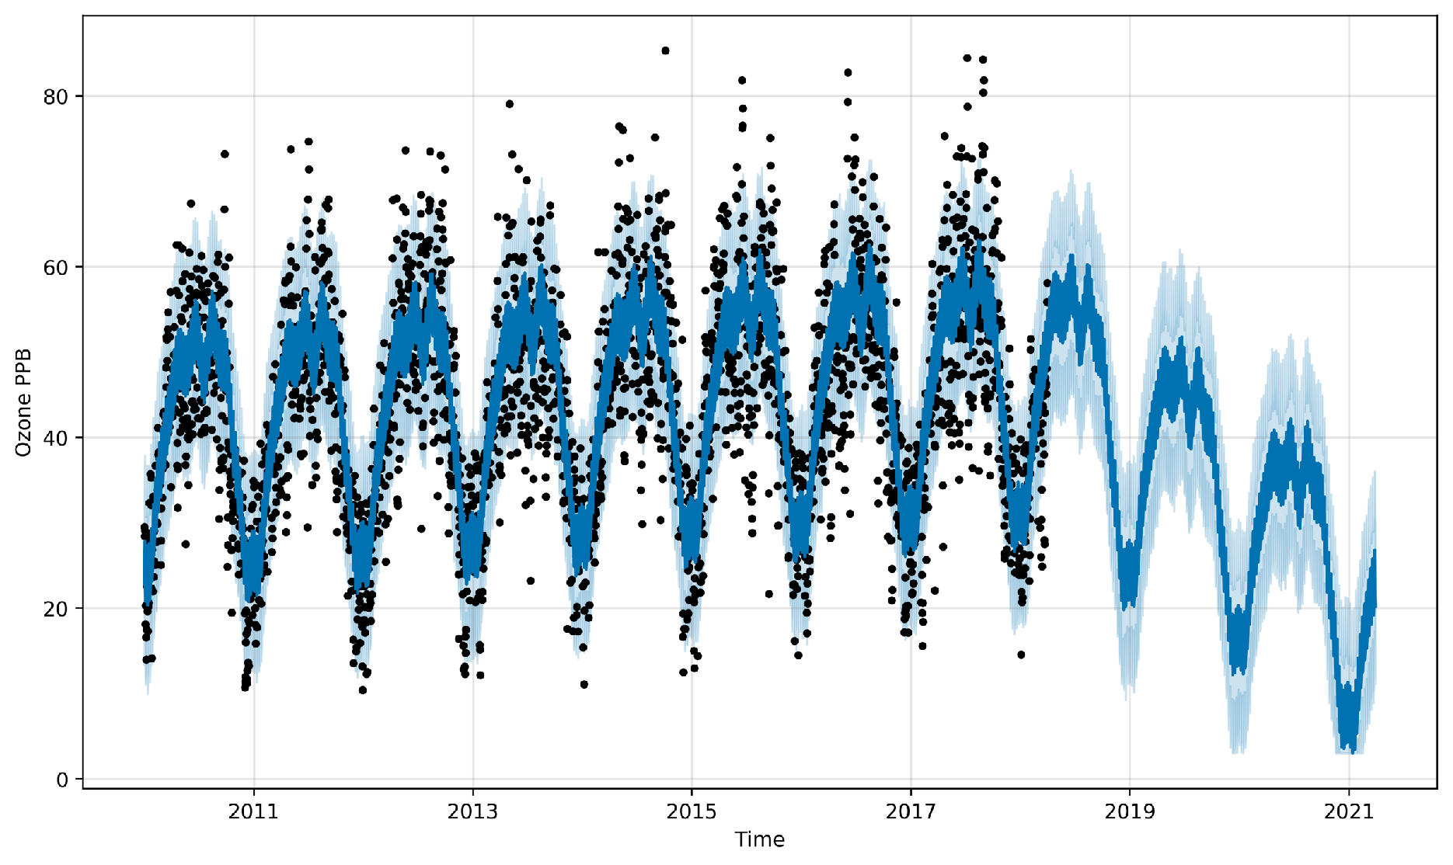
Projected Trend: Vertical Forest

Slide 19
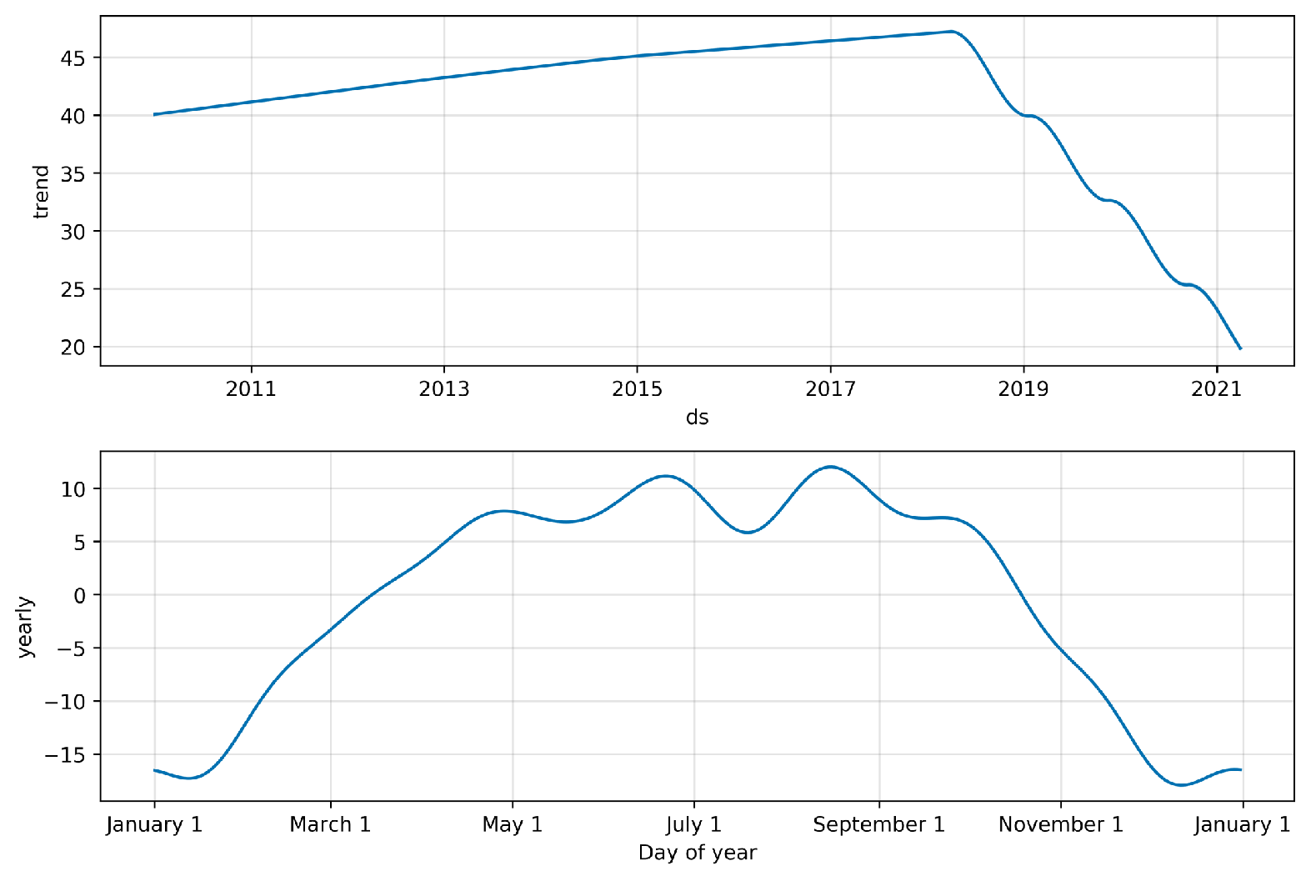
Projected Trend: Vertical Forest

